Slide 1
Health Insurance Claims Analysis
By: Silvio Zabala

Slide 2
Project Description
Overview: This project aims to analyze and visualize patterns and uncover trends in health insurance claims data by analyzing multiple variables.
Objectives: This project will focus on the following goals:
Explore and Analyze Claims Data
Uncover Claims Key Trends
Highlight Claims Data Outliers
Use of Interactive Visualizations

Slide 3
Datasets Used
Medical Claim Charges Dataset:
The first dataset was retrieved from Kaggle’s public datasets and provides demographics and Medical Insurance Cost for a small sample of the U.S.A. population.
https://www.kaggle.com/datasets/mirichoi0218/insurance?resource=download
CMS Claims Denials Dataset
The second dataset was retrieved from the Centers for Medicare & Medicaid Services (CMS) who are committed to increasing transparency in the Health Insurance Exchanges.
https://www.cms.gov/marketplace/resources/data/public-use-files

Slide 4
Research Questions
How do claim charges vary by demographic factors (age, sex, BMI, smoking status, and region)?
Which states or regions have the highest claim charges and denial rates, and how do they compare across regions?
What is the impact of smoking status and BMI on claim charges or denial rates?
Which states or regions have the highest claim charges and denial rates, and what demographic factors contributes to this?
Which state or region has the highest rate of appeals and appeals overturned?

Slide 5
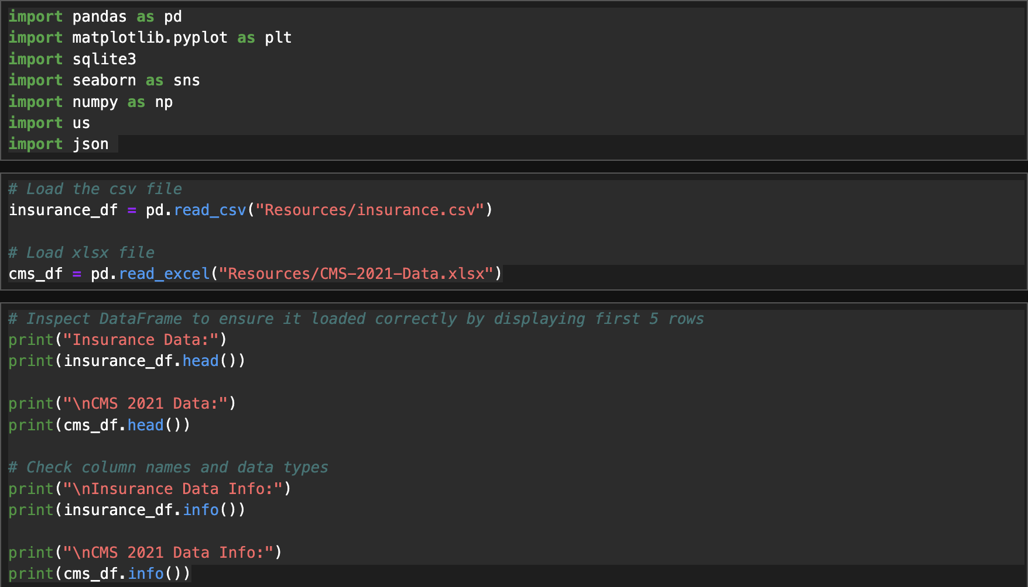
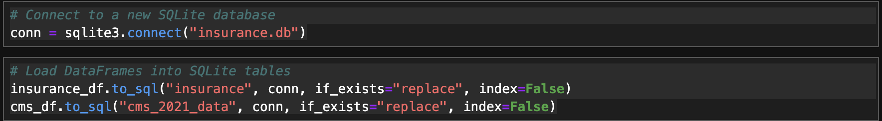
Data Preparation
Loaded 2 Separate Data Sources:
Loaded CSV and Excel files into a Pandas DataFrames.
To enable comprehensive analysis, I integrated data from two sources: the insurance claims dataset and the CMS 2021 claims denials dataset.
I stored both datasets in a SQLite database, allowing to query and analyze them together.

Slide 6


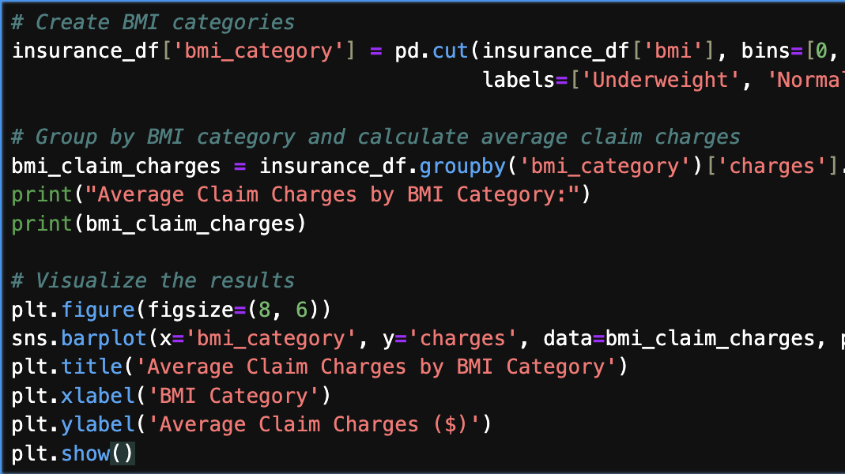
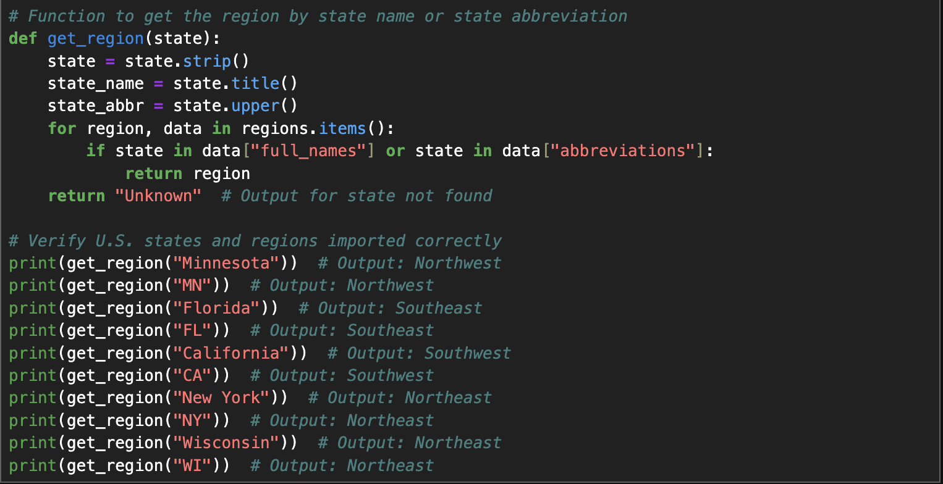
Data Preparation
Created New Features
Created BMI categories.
Mapped states to regions for geographic analysis.
I engineered new features to enhance my analysis. For example, I categorized BMI values into underweight, normal, overweight, and obese. This allowed me to analyze claim charges and denial rates by BMI category.
To enable geographic analysis, I mapped states to their respective regions using a custom function. This allowed me to analyze claim charges and denial rates by region for regional trends analysis.

Slide 7
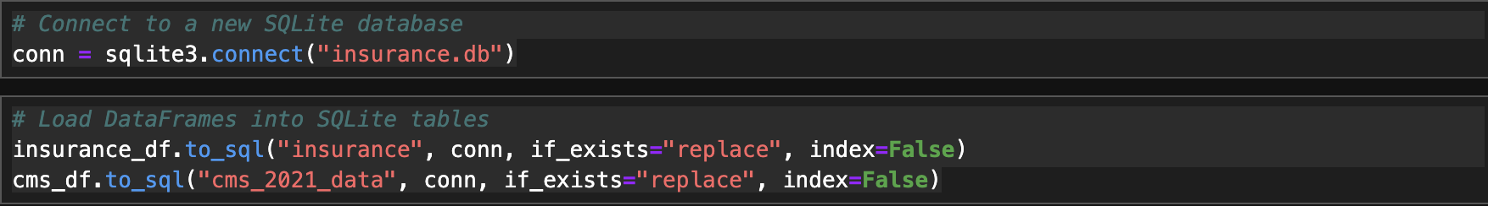

Data Preparation
Exporting Data:
Saved transformed data to JSON and SQLite database.
Exported the transformed and prepared data to JSON and an SQLite database.
This ensures that the data is easily accessible for future analysis and visualization.

Slide 8
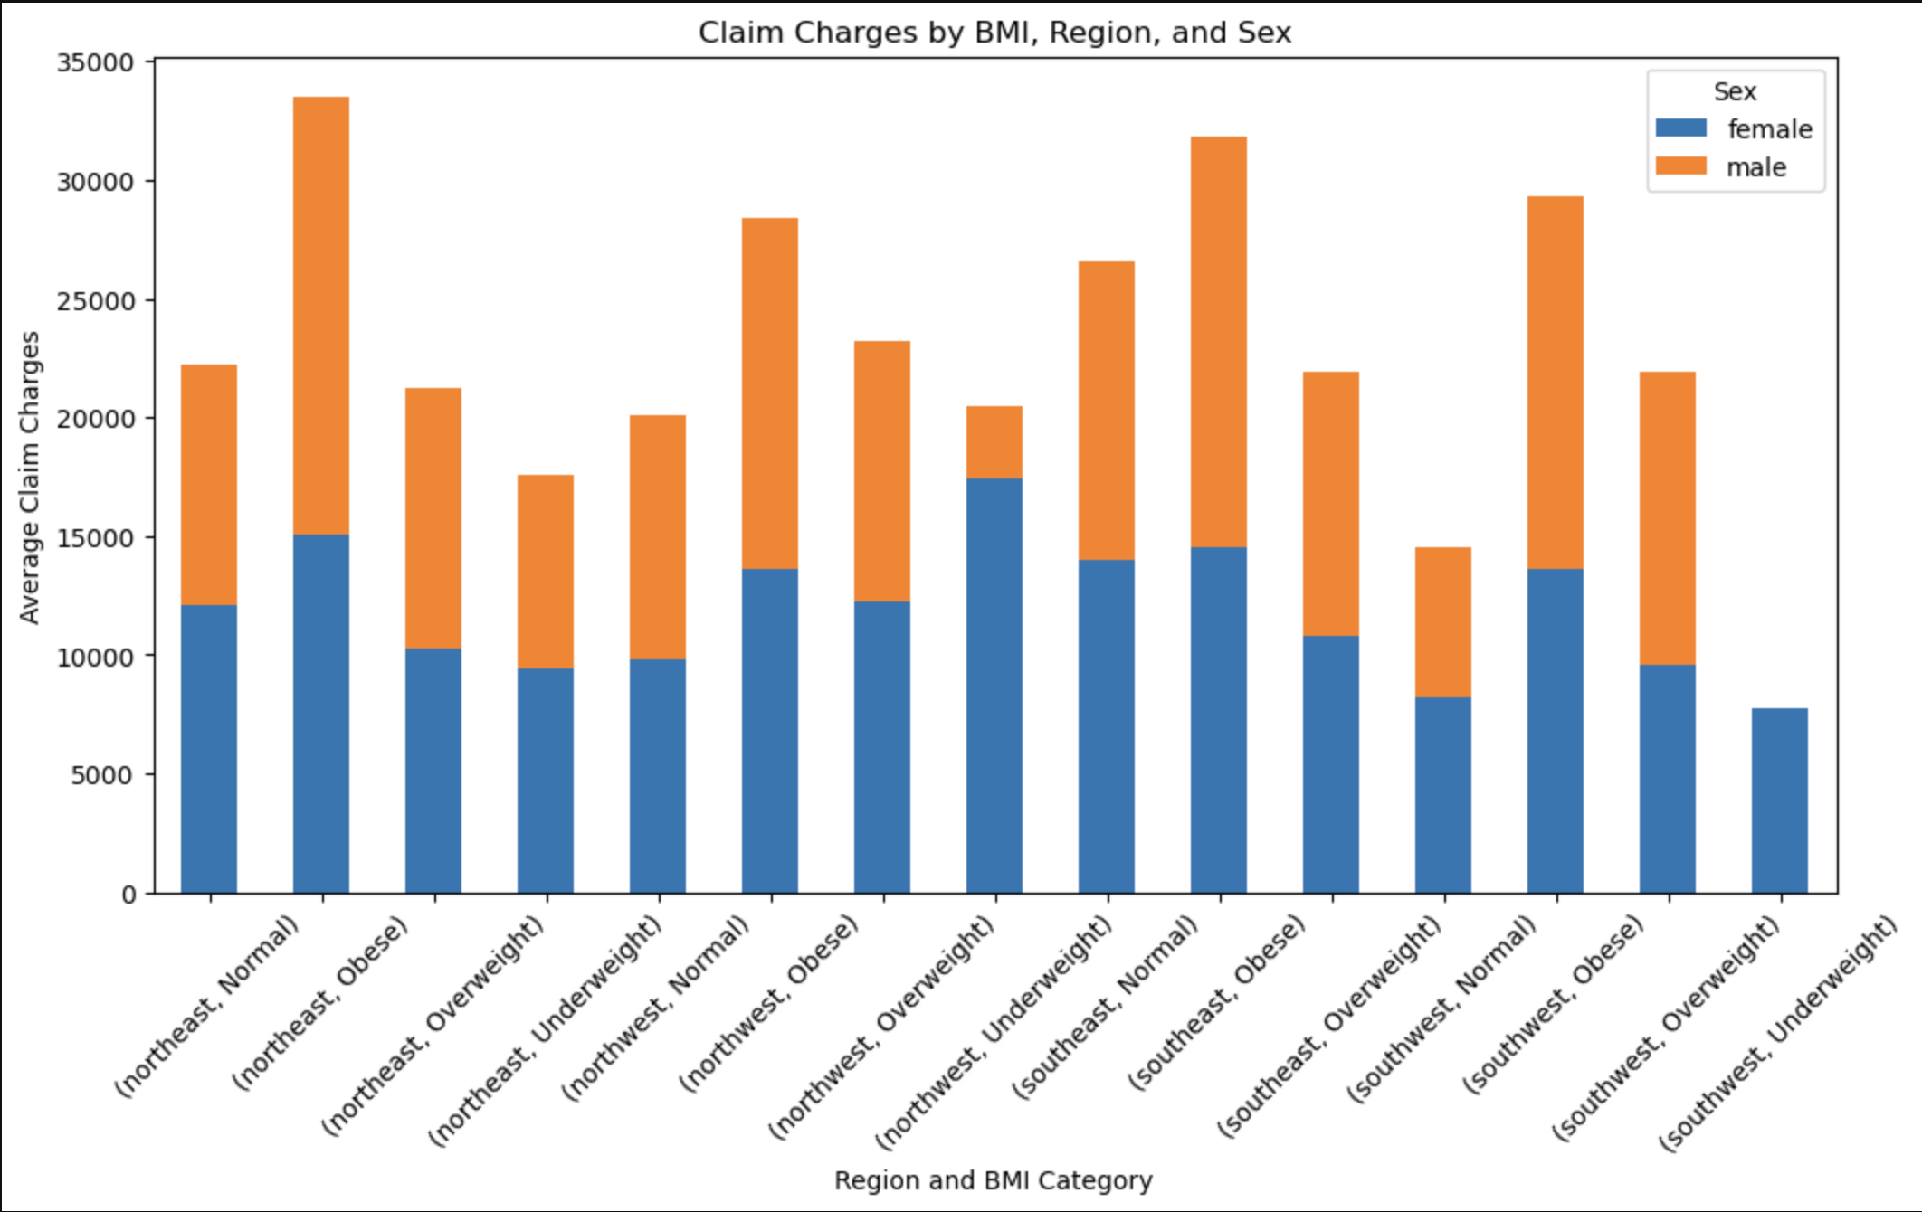
How do claim charges vary by demographic factors?
BMI: Higher BMI categories are associated with higher claim charges. This is likely due to the increased risk of health complications in individuals with higher BMI.
Region: Claim charges vary significantly by region. Factors such as local healthcare costs, availability of services, and regional health trends may influence these variations.
Sex: There are noticeable differences in claim charges between males and females.
Outlier: Underweight people in the southwest region have a lower average claim charges and generally the same average charges for both male and females.

Slide 9
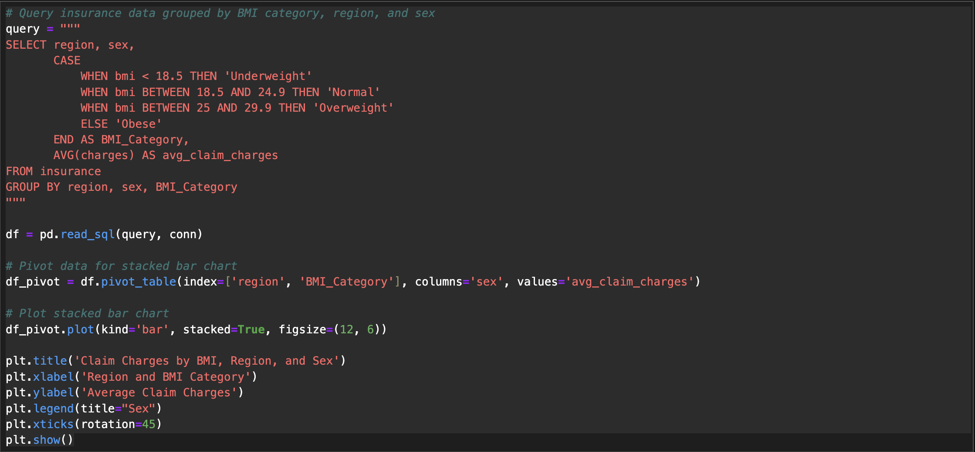
How do claim charges vary by demographic factors?
SQL Query:
Grouped data by region, sex, and BMI category.
Calculated average claim charges for each group.
Categorized BMI into Underweight, Normal, Overweight, and Obese.
Retrieved data into a DataFrame
Data Transformation
Pivot data for visualization
Visualization
Average claim charges by BMI category, region, and sex.
Customized with titles, labels, and a legend.

Slide 10
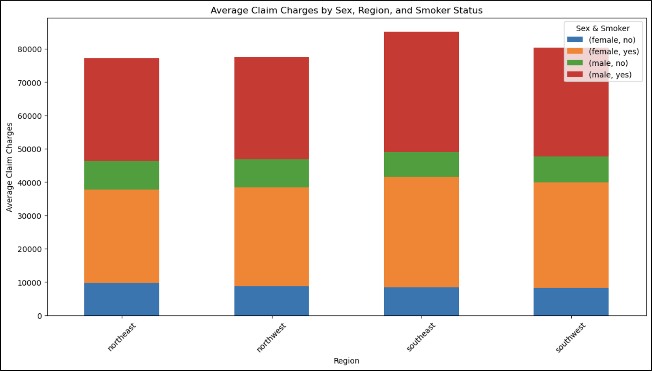
How do claim charges vary by demographic factors?
Sex: There are noticeable differences in claim charges between males and females. These differences are likely due to varying healthcare needs and utilization patterns between the sexes.
Region: With the demographics selected on this graph sex and smoker status, claim charges are similar across regions.
Smoker Status: Smokers typically incur higher claim charges compared to non-smokers, as smoking is linked to numerous health issues.
Male smokers tend to have higher claim charges.
Female smokers claim charges are still lower than non-male smokers across regions.

Slide 11
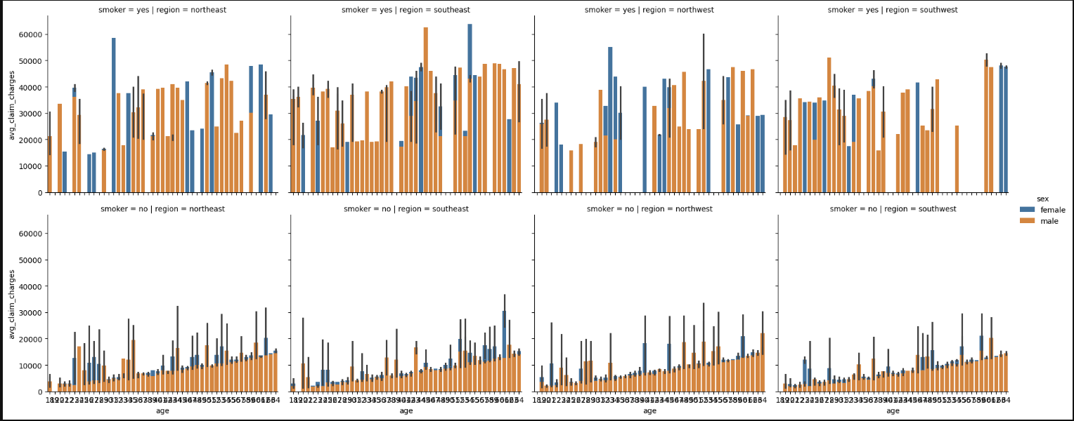
How do claim charges vary by demographic factors?
Notes:
Age: Claim charges tend to increase with age, as older individuals generally have higher healthcare needs.
Smoking Status: Smokers across all regions typically incur higher claim charges across regions, but smokers claim charges vary across ages and there is no positive or negative correlation with smoking and age and claim charges.

Slide 12
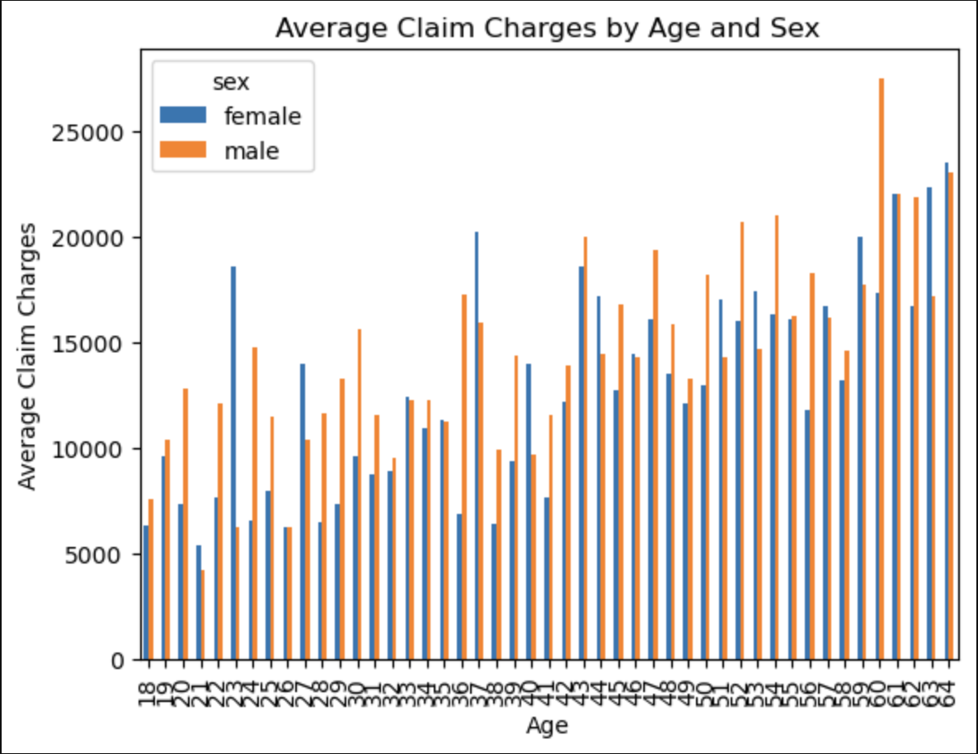
How do claim charges vary by demographic factors?
Age: There is a positive correlation with age and claim charges.
Sex: There are noticeable differences in claim charges between males and females on this graph as well.

Slide 13
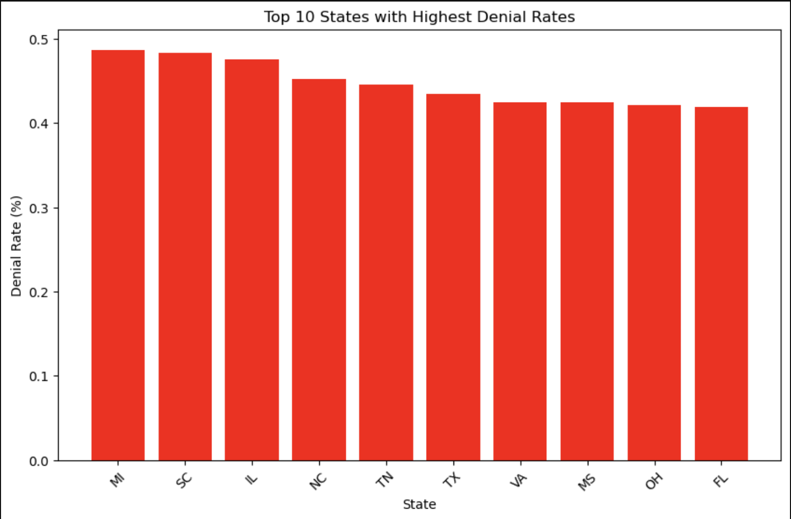
Which states or regions have the highest claim charges and denial rates, and how do they compare across regions?
Top 10 States with Highest Denial Rates:
Michigan
South Carolina
Illinois
North Carolina
Tennessee
Texas
Virginia
Mississippi
Ohio
Florida

Slide 14
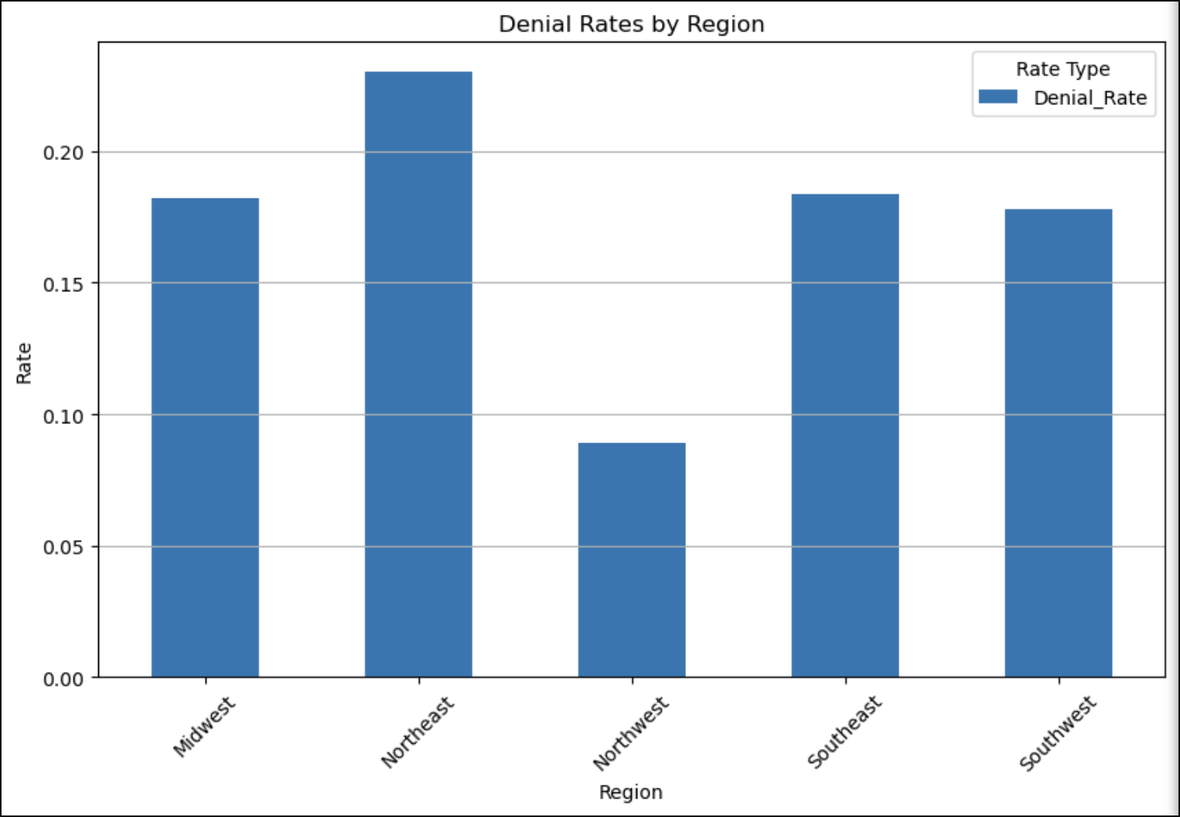
Which states or regions have the highest claim charges and denial rates, and how do they compare across regions?
States and Regions with Highest Denial Rates: Certain states or regions have notably higher denial rates. These states and regions are likely to have stricter claim approval processes. The denial rates can also be driven by specific health insurance carriers.
Comparison Across Regions: The comparison across regions shows significant variations in denial rates.
Outlier: The northwest states tend to have a lower denial rate than any other region.
Northwest States includes WA, OR, ID, MT, WY, MN, ND, SD and NE.

Slide 15
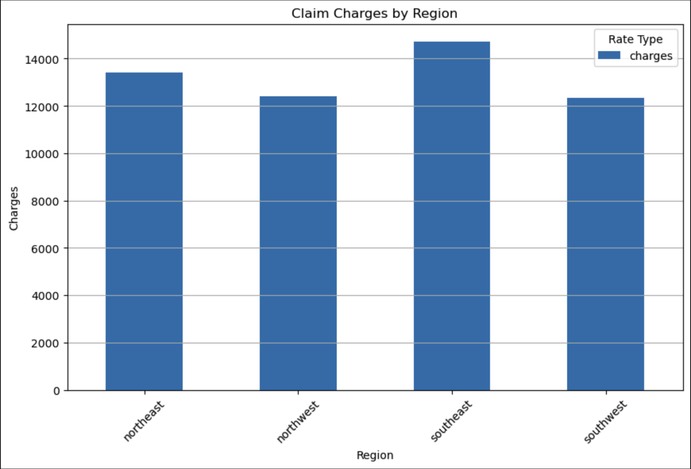
Which states or regions have the highest claim charges and denial rates, and how do they compare across regions?
Regions with Highest Claim Charges: Certain regions have notably higher claim charges. These states are likely to have higher healthcare costs or more healthcare needs.
Comparison Across Regions: The southeast region has the highest claim charges compared to the rest of the regions, and this is likely due to higher healthcare cost, availability of services, healthcare trends and needs.
Southeast regions includes DE, MD, WV, VA, KY, NC, SC, TN, GA, FL, AL, MS, AR and LA.

Slide 16
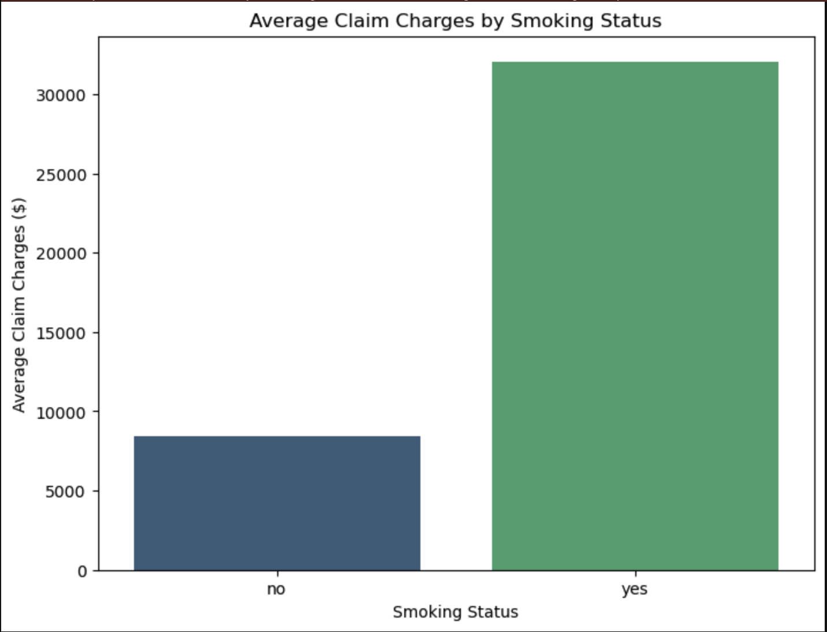
Which states or regions have the highest claim charges and denial rates, and how do they compare across regions?
Smoking Status: Smoking significantly increases average claim charges. Smokers typically incur higher claim charges compared to non-smokers due to the numerous health issues associated with smoking.

Slide 17
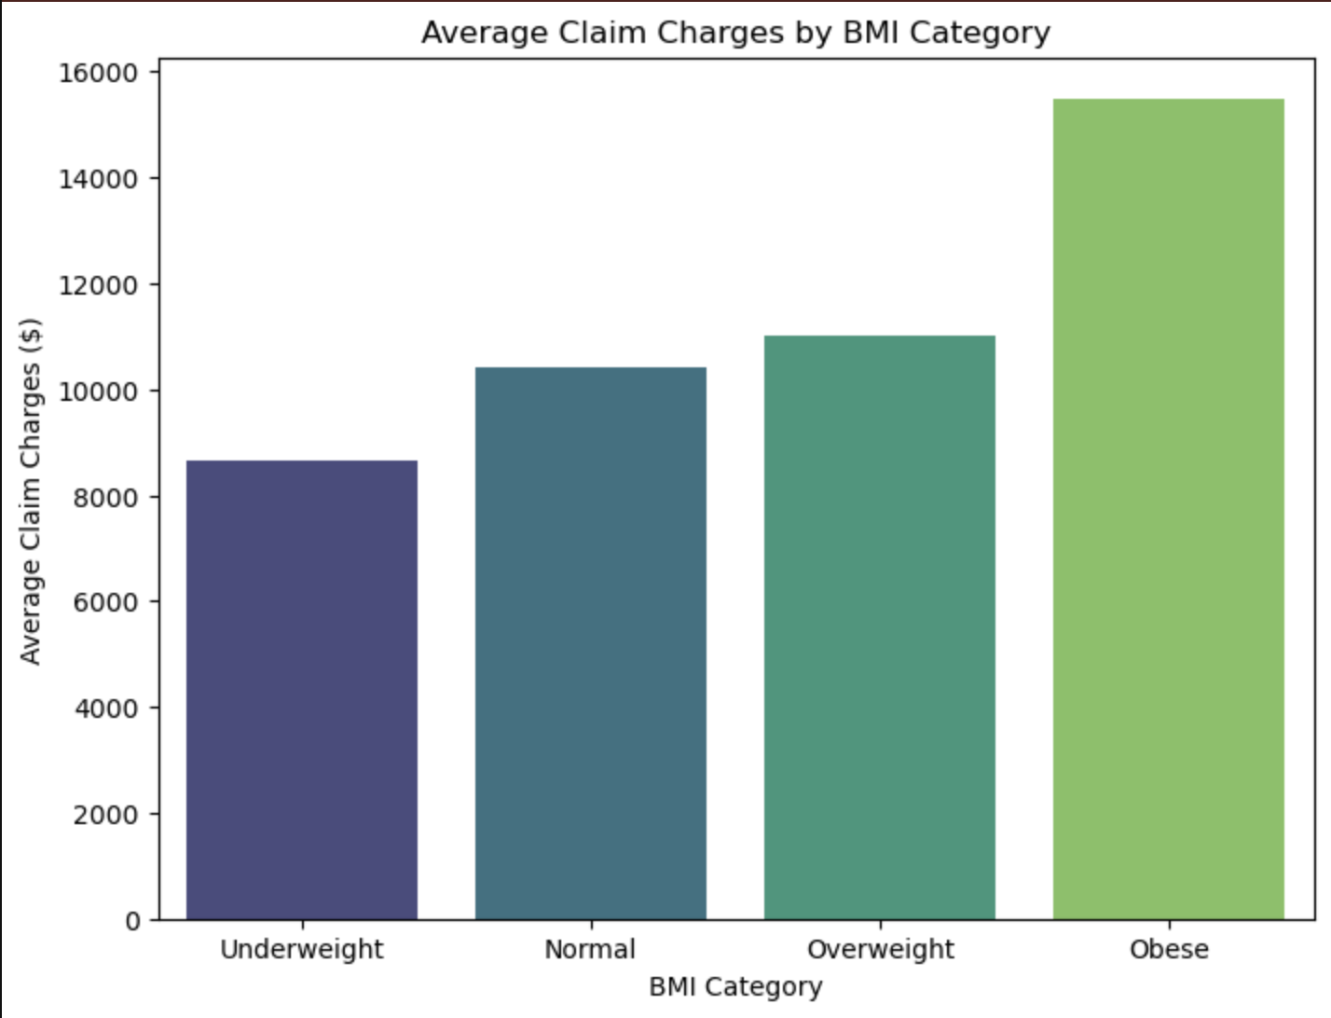
Which states or regions have the highest claim charges and denial rates, and how do they compare across regions?
Average Claim Charges by BMI Category:
Obese: $15,492
Overweight: $11,007
Normal: $10,405
Underweight: $8,658

Slide 18
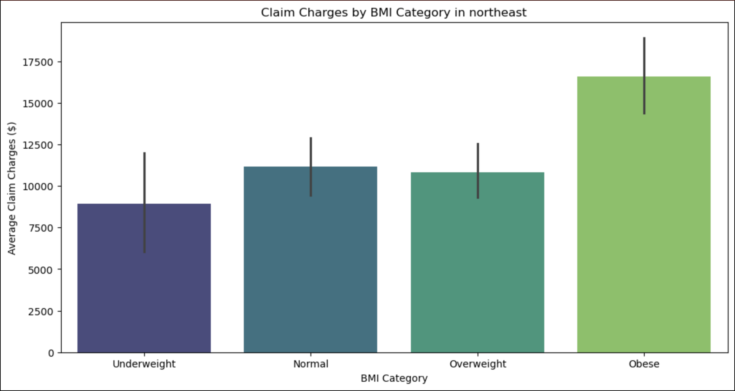
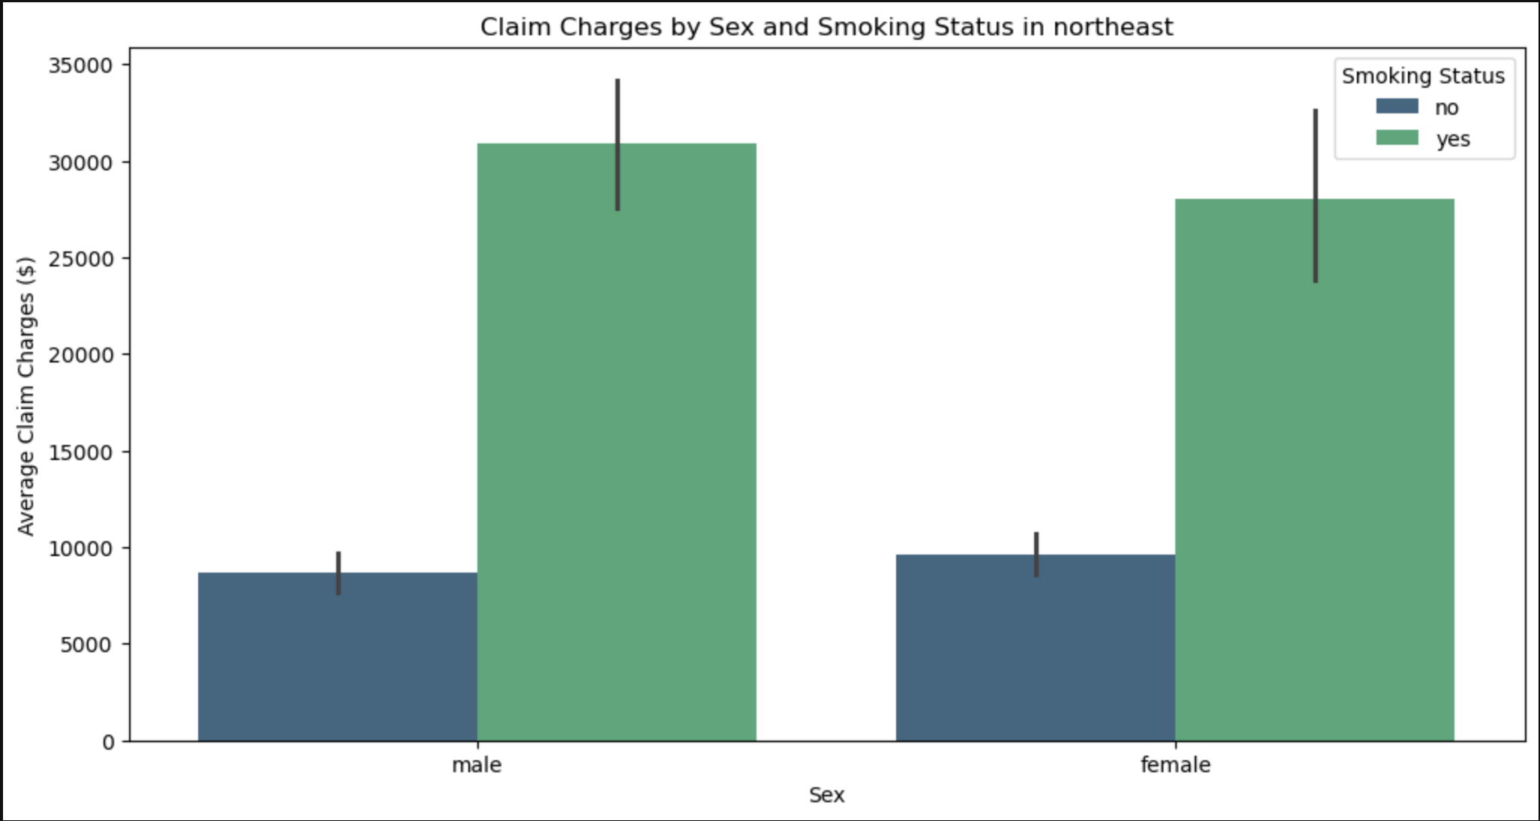
Which states or regions have the highest claim charges and denial rates, and what demographic factors contributes to this?
Northeast ranked as the top region with the highest claim charges with obese and smokers being the highest.

Slide 19
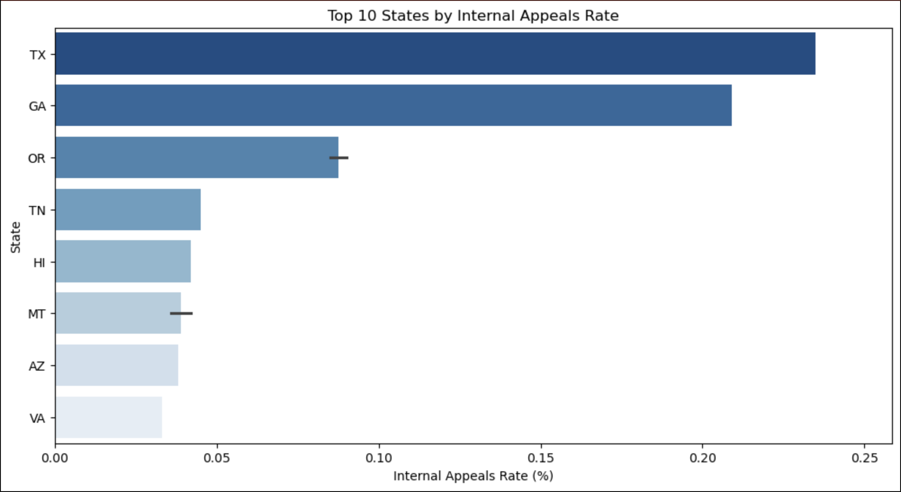
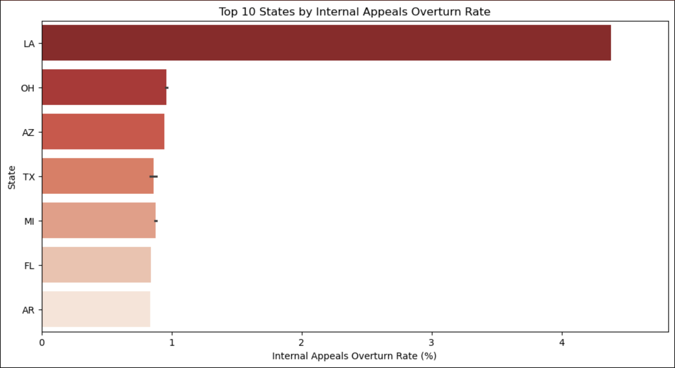
Which state or region has the highest rate of appeals and appeals overturned?
Top 10 States by Internal Appeals Rate: This graph shows the states with the highest rates of internal appeals. These states have a higher frequency of policyholders appealing against claim denials. This could indicate stricter claim approval processes or higher dissatisfaction with initial claim decisions in these states.
Top 10 States by Internal Appeals Overturn Rate: This graph shows the states with the highest rates of overturned appeals. These states have a higher success rate for policyholders who appeal against claim denials. This could indicate that many initial claim denials in these states are reversed upon review, suggesting potential issues with the initial claim review process.

Slide 20
User-Driven Interactive Dashboard
Features:
Interactive dropdowns for Region and Demographic selection.
Dynamic updates for three types of visualizations.
Visualizations:
Bar Chart: Average Claim Charges by Region.
Bar Chart: Total Claim Charges by Region.
Bubble Chart: Demographics vs. Total Claim Charges by region.
Technical Highlights:
Data loading and filtering with JavaScript library D3.js and Plotly.js.
Data aggregation using d3.rollup().
Simple and user-friendly design.
Example Use Case:
Explore claim charges in the Northeast region by smoker status.
Benefits:
User-friendly, insightful, and adjustable.
Notes:
To make the data exploration process more engaging, I developed a user-driven interactive dashboard using JavaScript libraries D3.js and Plotly.js. This interactive dashboard allows people to select a region and a demographic from one of the dropdowns menus. Based on the user's selection, the dashboard dynamically updates three visualizations:
A bar chart showing the average claim charges for the selected region.
A bar chart showing the total claim charges by region.
A bubble chart comparing total claim charges across different demographics (e.g., sex, BMI, smoker status) in the selected region.
The dashboard is powered by D3.js JavaScript library, which enables dynamic data binding and responsive visualizations as well as adapabality. It offers a user-friendly way to explore trends and patterns in the health insurance claims data.

Slide 21
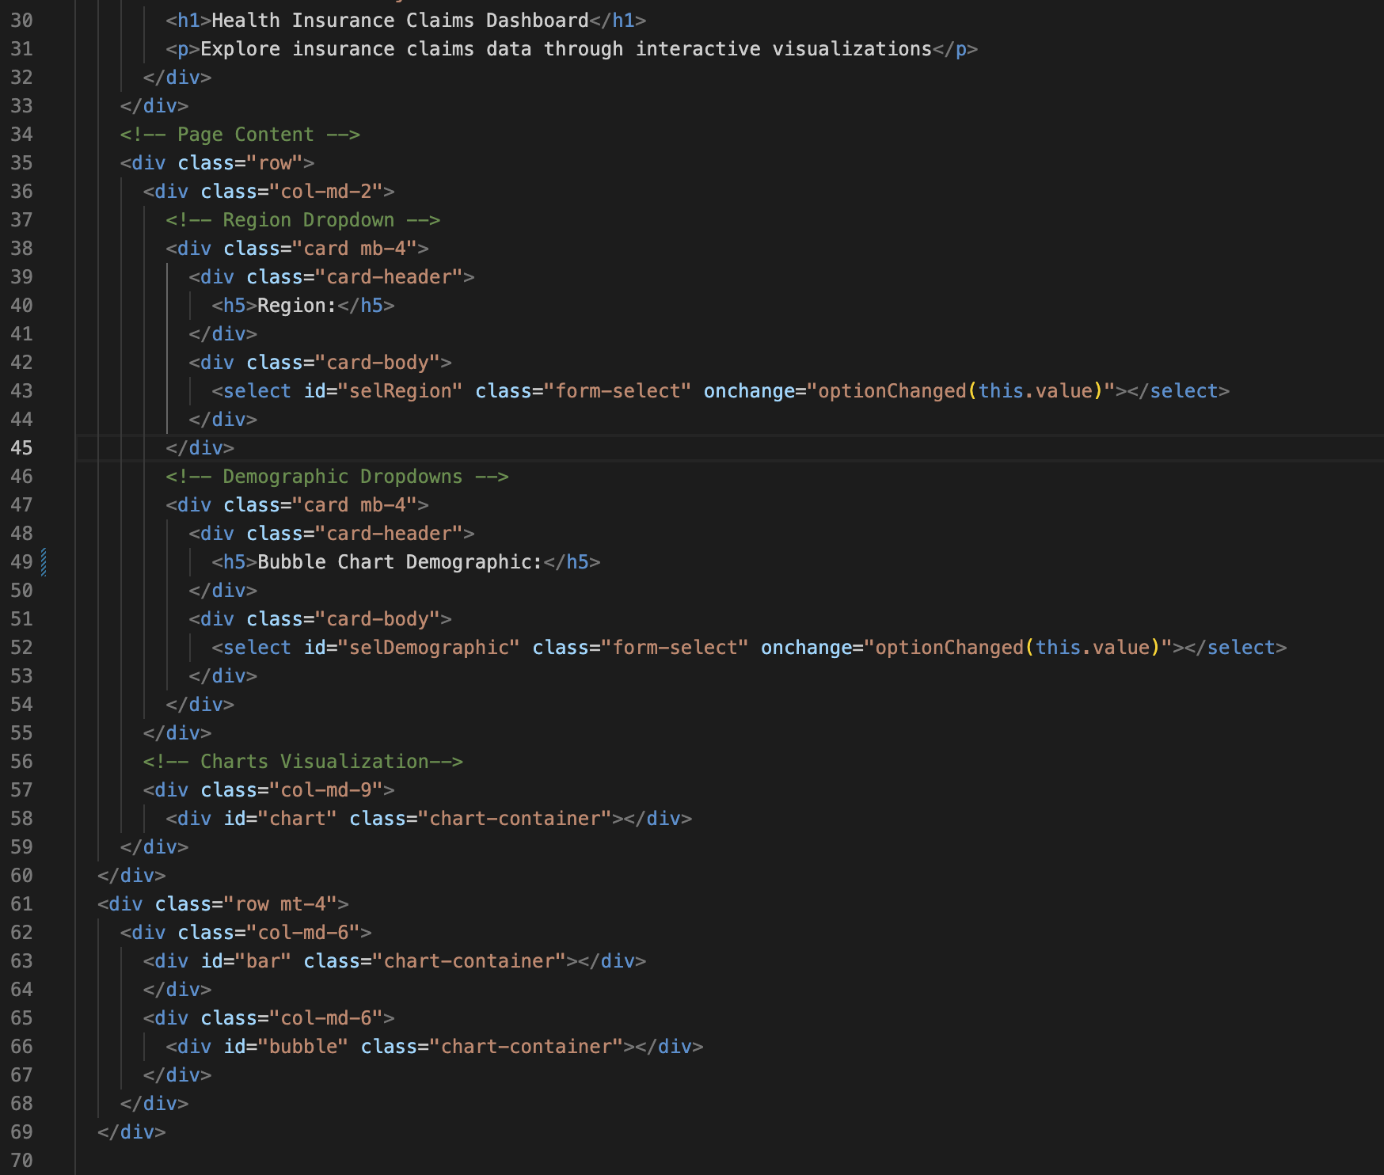
User-Driven Interactive Dashboard
Page Header:
Added Title
Description
Dropdown Menus:
Region Dropdowns
Demographic Dropdowns
Chart Containers:
Chart 1: Average claim charges by region
Chart 2: Total claim charges by region
Chart3: Demographics Vs Total Claim Charges
Layout:
Dropdowns on the left and and charts on the right.
Bootstrap grid system

Slide 22
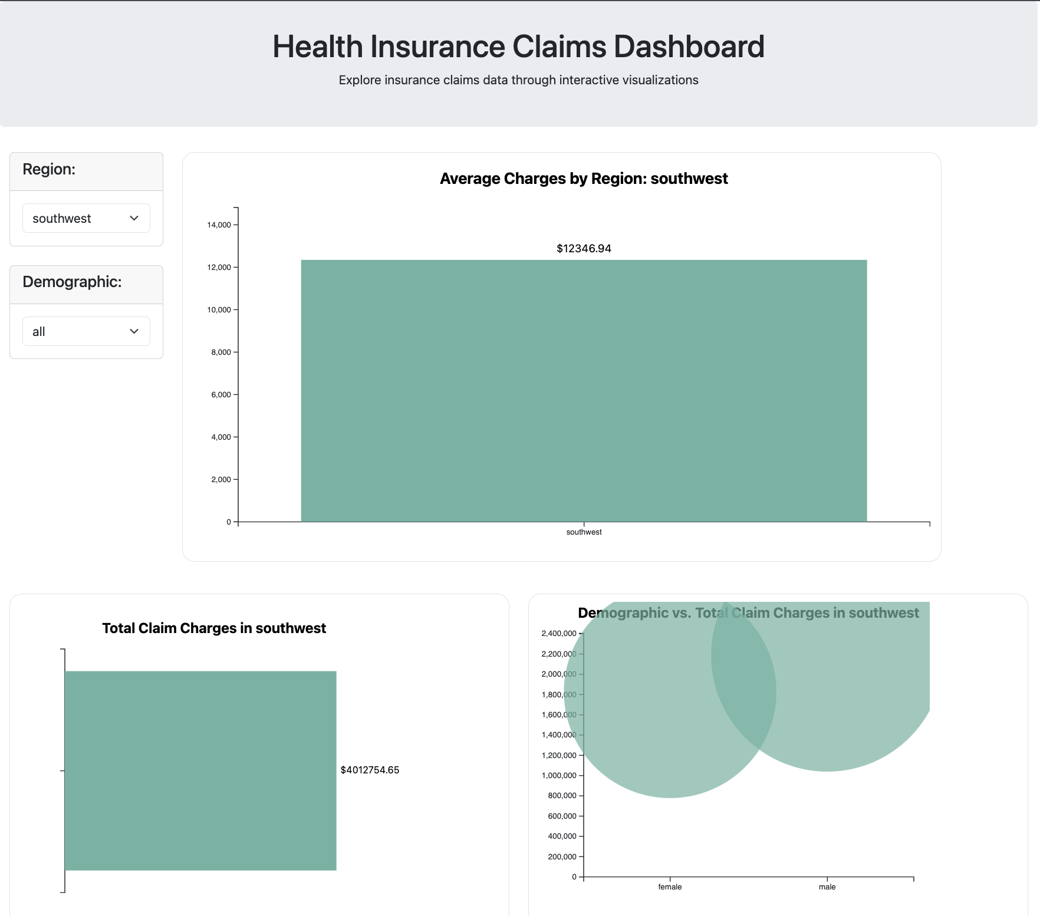
Health Insurance Claims Dashboard
Explore insurance claims data through interactive visualizations

Slide 23
Conclusion
To Summarize:
I identified trends in claim charges by region, demographics and smoking status as well as claim denial trends by regions.
Impact:
Inform insurers and the public of health insurance trends to spark conversations about actionable changes.
Further Research:
Further research is always helpful to understand health insurance claim trends accounting for more variables outside of this project.

